Slide 3
[Your Name]’s Trip to [country] with Engineering Ministries International
Insert picture of you in-country here.
Tell a quick teaser story of your trip.

Slide 4
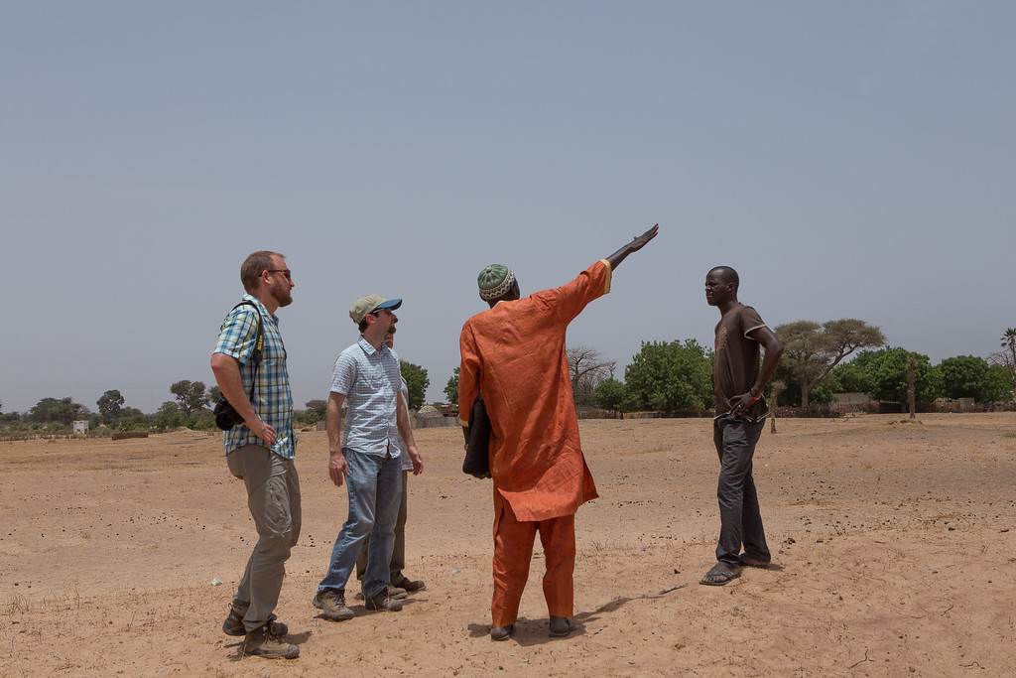
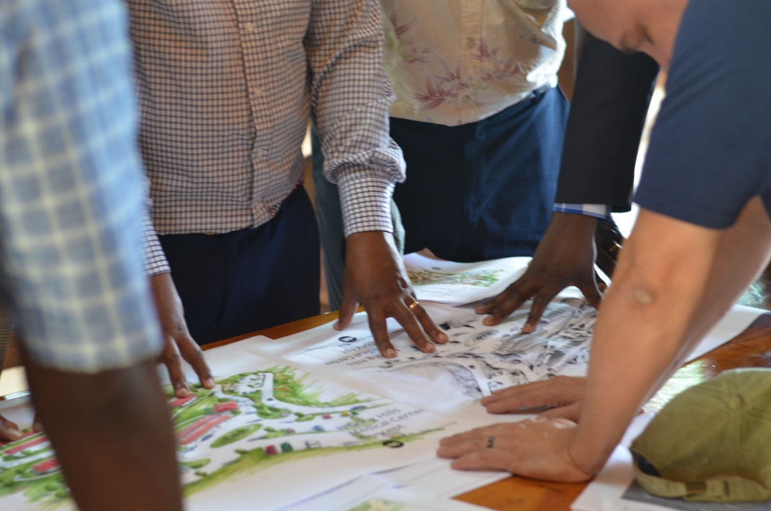
Who Is EMI
EMI is an international development organisation made up of architects, engineers, surveyors, construction managers and other built environment professionals who use their skills to serve the poor and least reached worldwide.
EMI’s multidisciplinary design teams collaborate with non-profit organisations and with Christian ministries to design culturally appropriate facilities that are sustainable, affordable and transformational. We design hospitals, schools, churches, children’s homes, water systems and many other facilities that catalyse our partner organisations to fulfil their calling and transform their communities.
Together we are designing a world of hope.

Slide 5
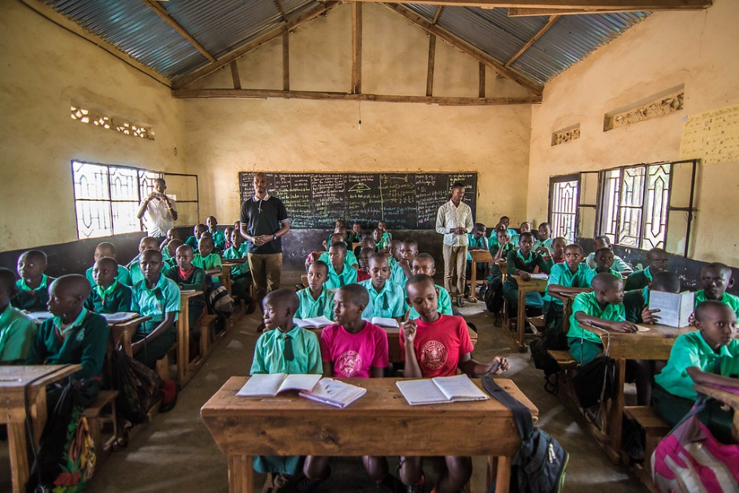
Our vision is to see people restored by God and the world restored through design.

Slide 6
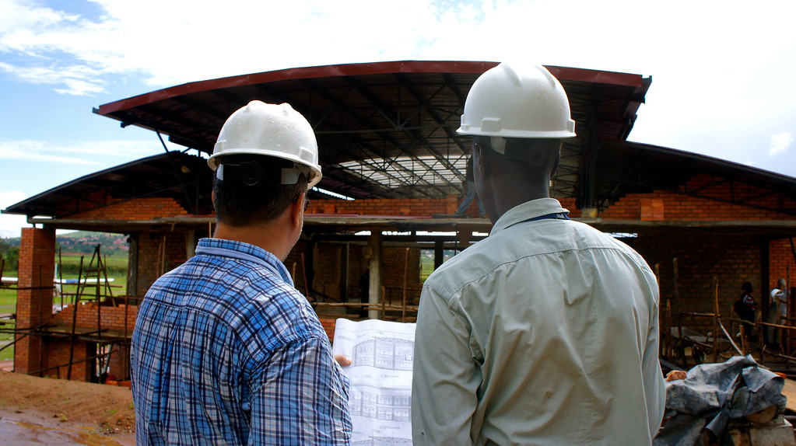
Our mission is to develop people, design structures, and construct facilities which serve communities and the Church.

Slide 8
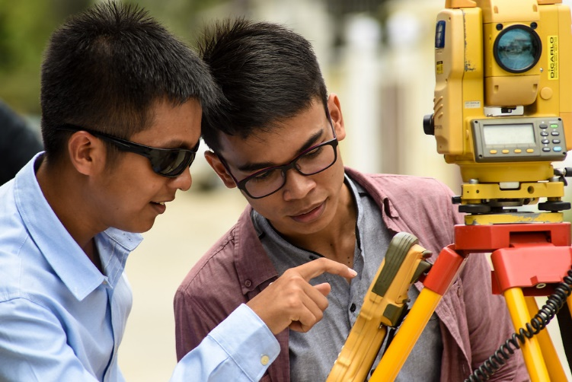
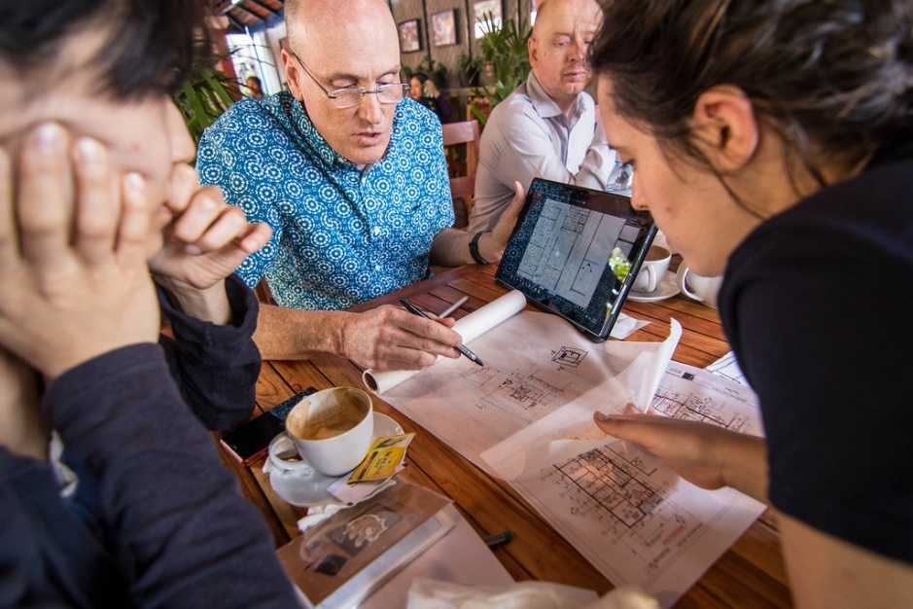

Slide 9
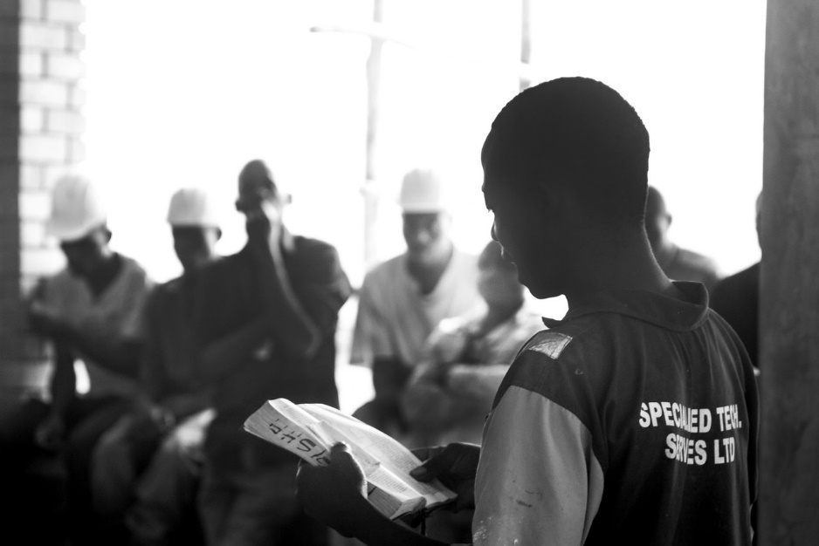
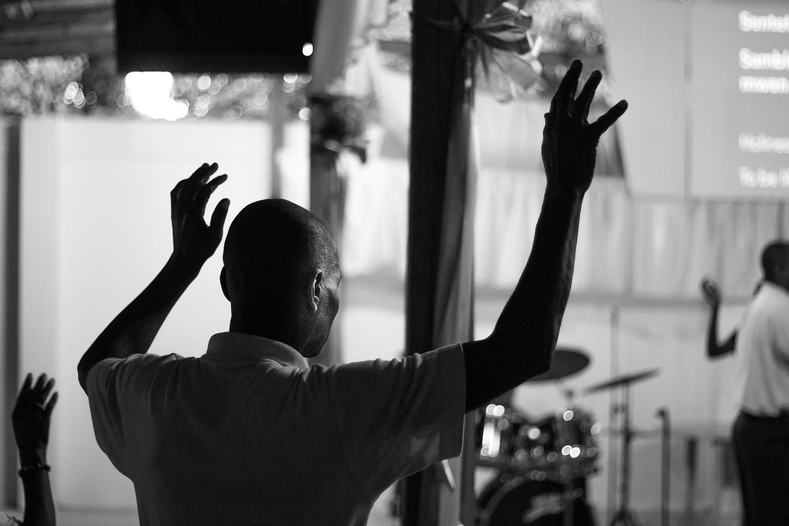

Slide 10
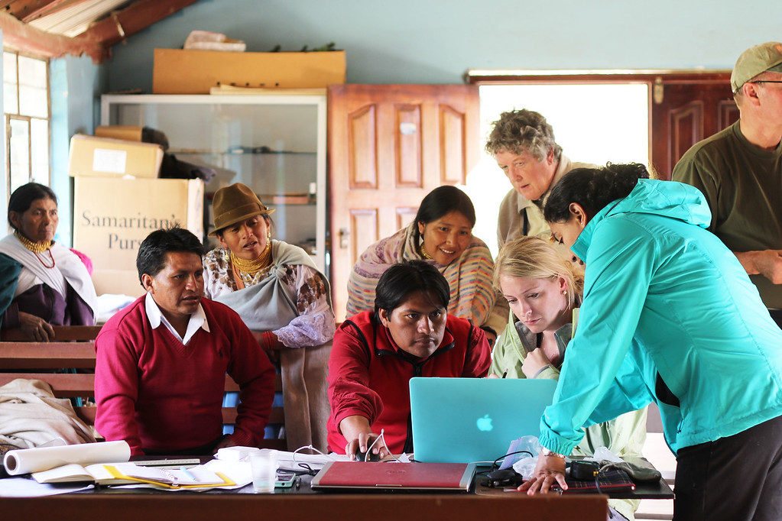

Slide 11
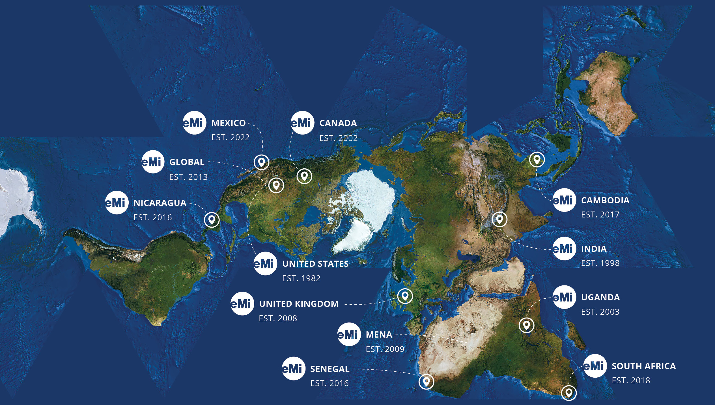
EMI AROUND THE WORLD*
THE FULLER PROJECTION MAP DESIGN IS A TRADEMARK OF THE BUCKMINSTER FULLER INSTITUTE. ©1938, 1967, & 1992.
ALL RIGHTS RESERVED, WWW.BFI.ORG.
TM

Slide 12
EMI PROJECTS IN 2021

Slide 13
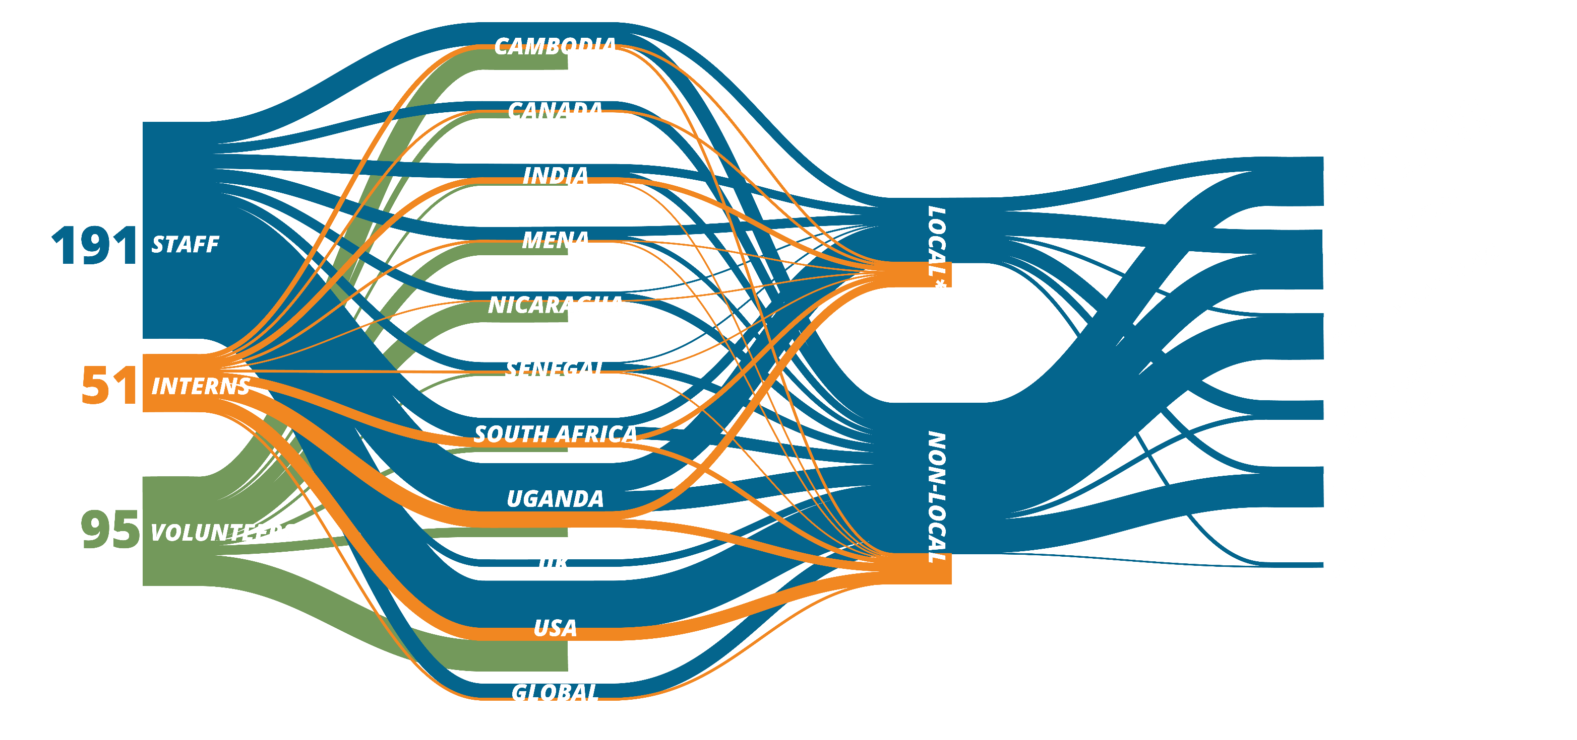
EMI PEOPLE IN 2021

Slide 14
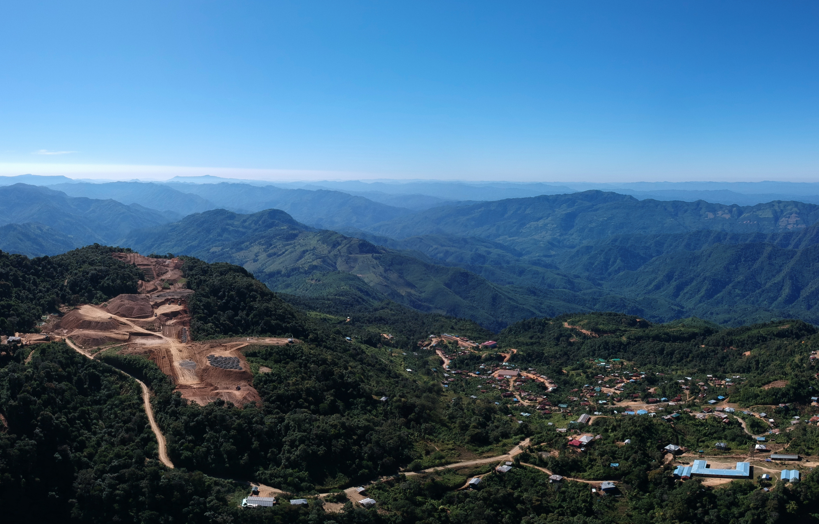
2021 Financial Report Summary

Slide 15
[Project type] Design in [Country] with EMI
Insert picture of you in-country here

Slide 16
[Country Name]
Insert map of the continent in which the country resides
Enter zoomed-in map of the country

Slide 17
The Ministry
Photo representing the ministry
[Name of Ministry being served]
[project that the EMI team designed, i.e. School for the Deaf, Hospital]
[about the ministry, i.e. The need of those being served
[A short sentence about the ministries impact]

Slide 18
The Project
Photo representing the project or project team
[Project Type] Design
[The general scope of the project]
[list aspects of the project scope]
[list aspects of the project scope]
[project design challenges]
[A short sentence about how the complete project will impact those in need]

Slide 19
[Personal Story Title]
This slide would be used for you to tell a personal story from your trip
Who
What
How it was impactful

Slide 20
Next Steps for the Project
The design will be completed [estimated date]
Construction is hoped to be started [estimated date]
The project is hoped to be completed [estimated project completion date]
Current ministry challenges
List challenges

Slide 21
Get Involved

Slide 22
Thank you Questions?
Insert picture of you in-country here

