Slide 1
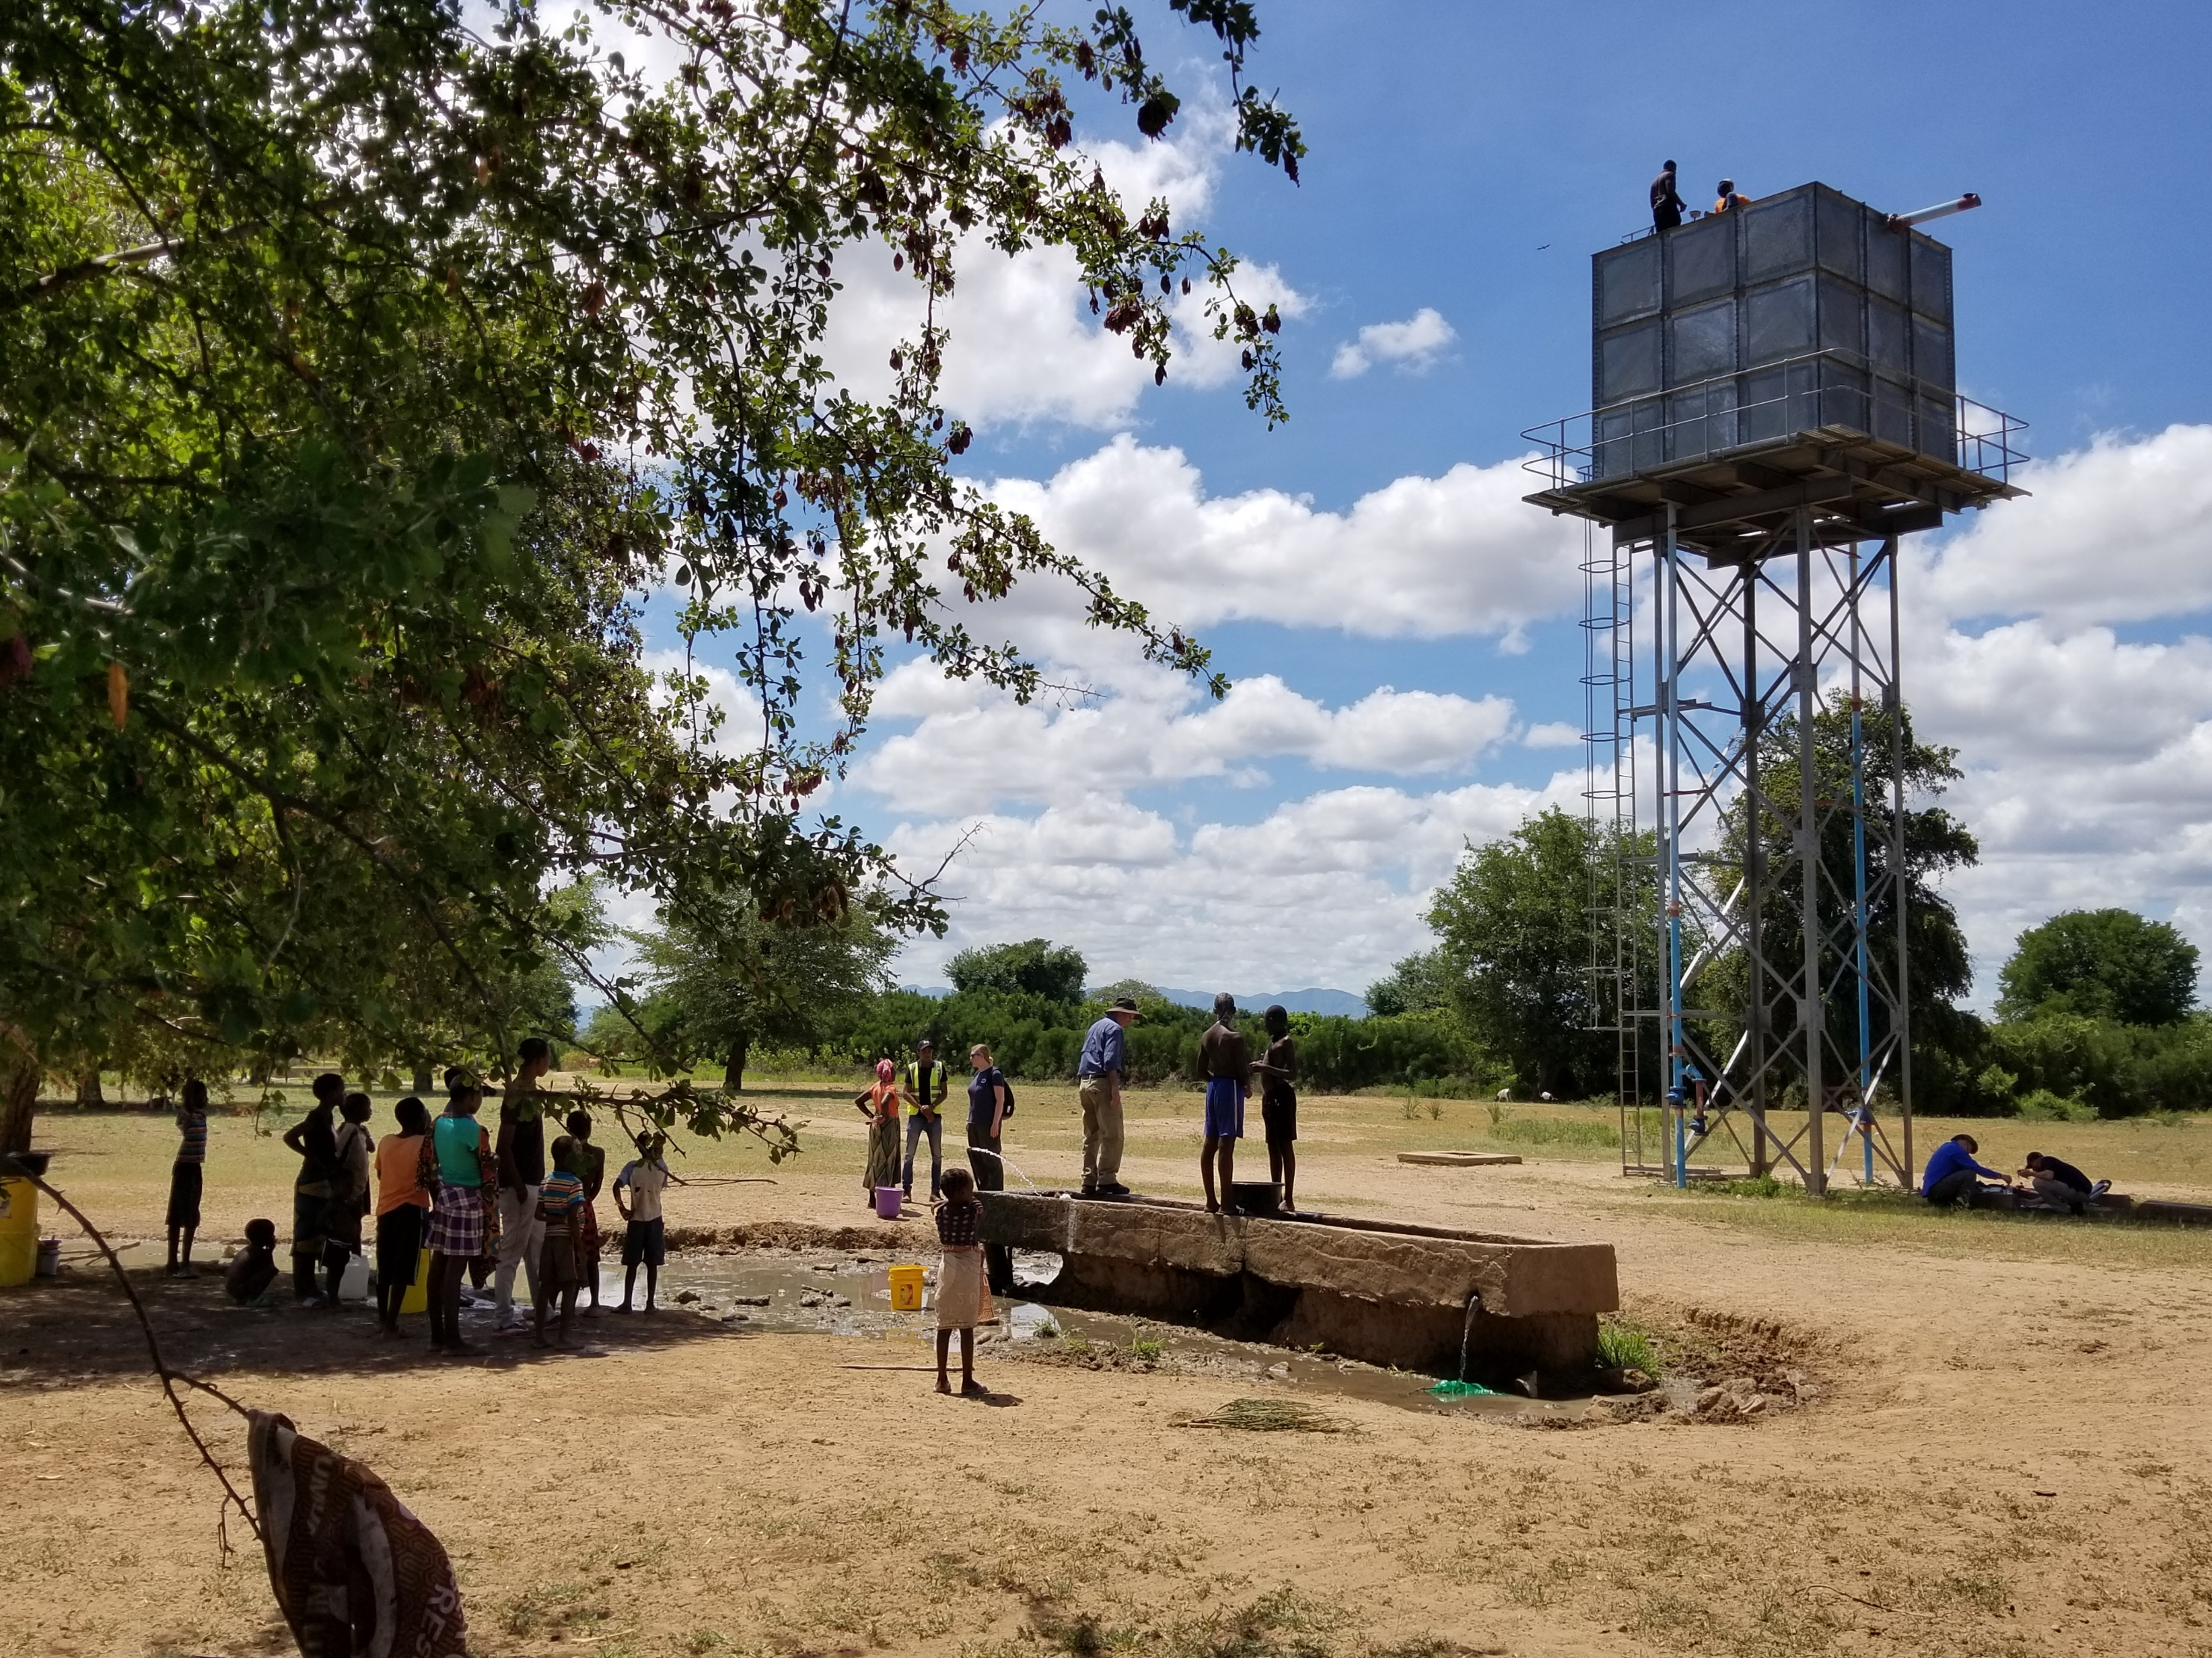
WASH
Theory of Change

Slide 2
Outline
Restoration in WASH
WASH Theory of Change Introduction
The science of behavior change
RANAS behavior change model
Application

Slide 3
Personal Bio
Notes:
From Toronto, water engineer focusing in on WASH + church planting
Did my internship in Cambodia in T3 2022, was so nice that I had to do it twice, just finished another 6 months in Cambodia using grad school experience for networking, training, and setting strategy for WASH (and of course spending time with the wonderful people at PETRAM). It is a pleasure to share some of those lessons with you all today.

Slide 4
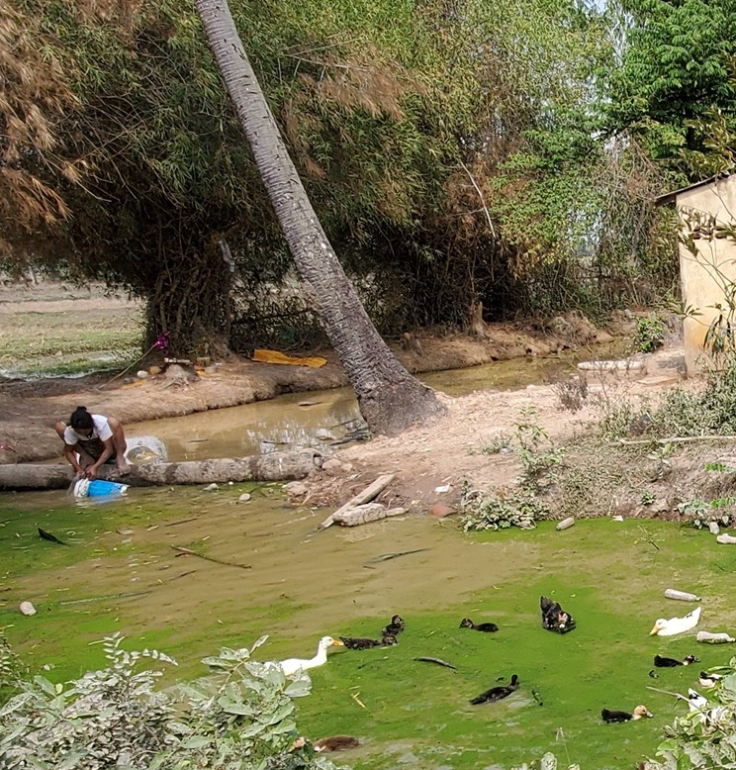
Restoration in WASH
The goal is to reduce the burden of diarrheal diseases on developing communities through improved WASH
Notes:
Before we dive into WASH theory of change, I want to spend some time adding to our vision/motivation of what we’ve heard about WASH with experiences from Cambodia. Why is WASH an important sector for us to engage with? Jesus’ ministry (and the EMI vision) is to simultaneously partner in the restoration of people by God, and the world through design.
Testimony from Cambodia. Use the picture to explain the restoration through design.
Use testimony to show how it’s related to the restoration of people.
WASH is a very critical need of the world today, and I’m excited to see how EMI continues to grow into these opportunities.

Slide 5
WASH Theory of Change
Behavior change is the focus, not just changing environments
Interventions that focus on hardware are less sustainable
Notes:
So how do we engage with WASH well? Today I’ll be presenting another aspect of WASH programing that is of great important, the WASH theory of change.
A Theory of Change is a detailed explanation of how desired change is expected to happen in a particular context. Within the sector of WASH, what do we usually mean? What are we changing? Our goal in WASH is not just about changing their environments. Ultimately, it’s changing their health behaviors. This is important, because this means that the focus shifts. Our focus cannot be on the infrastructure for WASH. That’s usually a minor component of change.
We need to support communities in increasing access to WASH, but we also need to help them develop new behaviors. Why is behavior change the focus? Because decades of WASH programs show that infrastructure by itself does not mean sustainability.
3 cases, first about anecdote about Prof. Meyer and rural housing in Africa host family. Then explain the pictures
Why do we need to focus on behavior so much? Because historically in WASH what we have seen is that changing infrastructure by itself rarely leads to successful health benefits. What is happening? Well-intending people have dug wells, built latrines, provided supplies of soap, but they haven’t spent enough time understanding local values and behavior.
It’s not just about bringing WASH on the technical front. It’s mostly about changing behavior.
Doesn’t matter if we give them clean water, if they don’t want to use it
Give examples. What’s the main risk of this? Many, but one of the big ones is that unsustained usage will NOT see health change. This runs the risk of reinforcing the idea that WASH is an inconvenience, not a necessity. So let’s talk a little bit about the science of behavior

Slide 6
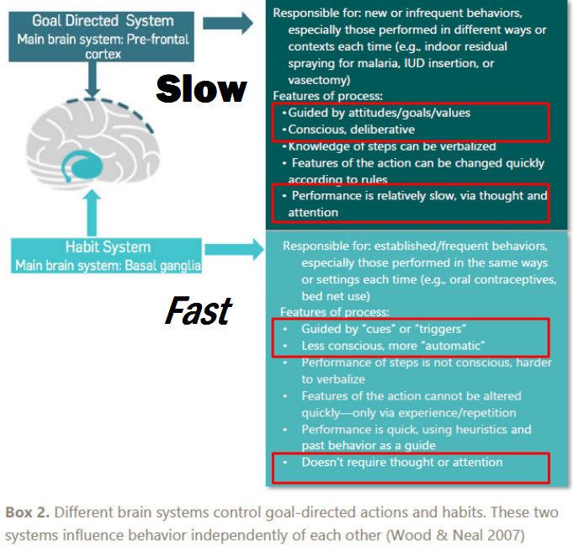
Science of Behavior
Comprised of intentional actions and habits
Intentions dictate in the short term, habits dictate in the long term
Notes:
Behavior is comprised of two main components. It starts with intentional actions that we need to learn. Overtime, as those actions are repeated in a stable context with sufficient rewards, they become habits. This happens all the time, think about learning how to brush teeth as a child. There was a time where we all had to learn how to brush and put conscious thought into the action every time. Now, I’ll assume that all of us have formed a habitual routine such that it’s automatic.
Habits use a different part of the brain. It’s in the brain for efficiency, it’s fast, requires less “programming” power
In the long term, in a stable environment, Habit dictates behavior, not intent.
What happens if we design a program to change behavioral intent but neglect the aspect of habits? Think of new year’s resolutions and why so many of them fail.
What does this tell us? That a comprehensive plan for changing behavior will start with an understanding of what informs a community’s Goal System, as well as understand what context cues inform their habit systems.
So, knowing that, I’ll be presenting on a behavior change model that actively includes strategy for behavior + habit for you all to consider.

Slide 7
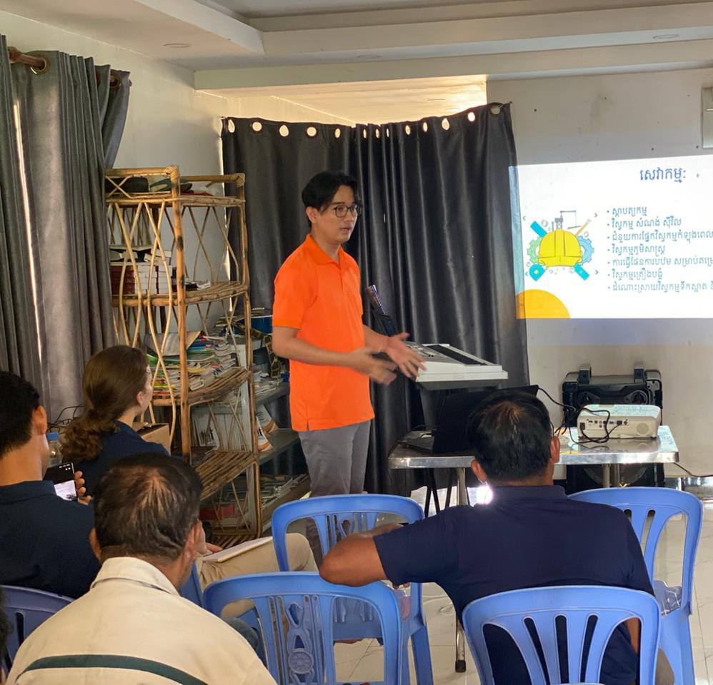
Behavior Change Theory
Theories that propose what factors drive intentions and what context cues drive habits
The goal: To apply these theories to promote behavior change in communities
Notes:
What tools can we use? We can take the science of Psychology and as Engineers, apply that to our contexts. Behavior change theory includes trying to understand what factors affect behavior, as well as planning to address those factors to see people’s habits change. Engineers are applied science. We take the science of behavior change and apply it to our contexts.
How can we apply behavior change theory to improve our programs?
Discussion on changing intentions, behavior, and habits.
Typically, we stopped at initial behavior interventions, education, training, various ceremonies, etc. But it’s more complicate than that because of habits.
We can then understand the factors to design a comprehensive and appropriate intervention that promotes the behavior that we want to encourage.

Slide 8
Behavior Change Models
Aim to analyze and form inferences on community behavior based on internal and external factors
Aim to answer questions such as:
What motivates behavior?
How do we start to understand context cues?
Design solutions to promote behavior change
Notes:
What do we need to do to change and influence goal systems?
How to encourage new repeated repetition behavior? How do we start to understand the context cues? How do we consider external factors that come into place in behavior of a context? How do we understand what rewards would be appealing?
How do we understand the goal system of a context and how we might be able to replace it? BCTs give us structured ways of thinking and help us show our due diligence. Hundreds exist in literature, but for the sake of time I’m going to present one with a high reputation for WASH applications as a strong starting point.

Slide 9
Introduction to RANAS (Mosler, 2015)
Risk | Attitude | Norm | Ability | Self-Regulation
Notes:
Begin by setting expectations. All models are wrong, but some are helpful. Think of the models of the atom we learn in high school. None of them are completely right, but they’re very useful, nonetheless.
The goal is to add rigor and comprehension to our WASH interventions, which would increase rate of success and show due diligence to our funders. Also, we provide structure around which factors to investigate to inform our theories.
RANAS theory of change (Mosler, 2015). A helpful structure to get started that leverages many psychological behavior change models and communicates them in a behavior change process tailored for WASH.

Slide 10
RANAS Theory of Behavior Change
6 Behavioral Factors and Behavior Change Techniques
3 Behavioral Outcomes
3 Contextual Factors
Notes:
RANAS model stands for the 6 behavioral factors that they propose define behavioral outcomes in WASH.
Risk – A person’s understanding and awareness of the health risk
How can we influence this factor?
Attitude – Positive or negative stance towards a behavior
How can we influence this factor?
Norm – The perceived social pressure towards a behavior
Ability – Confidence in ability to practice behavior
Self-regulation – Ability and their attempts to plan and self-monitor behavior, along with manage conflicting goals and bad habit cues.
3 Behavioral Outcomes:
Intention – People willingness to perform this behavior
Use – People are actively practicing this behavior
Habit – People are practicing these behaviors long enough and in a stable context such that it becomes habit
3 Contextual factors:
Social – culture and social relations, laws and policies, economic conditions, and information environment
Physical – Natural and built environment
Personal – age, sex, education, mental/physical health of the individual
So, what does it look like to put this theory into practice? The creators of RANAS have created a WASH organization, and so they also have resources for how they apply this theory.

Slide 11
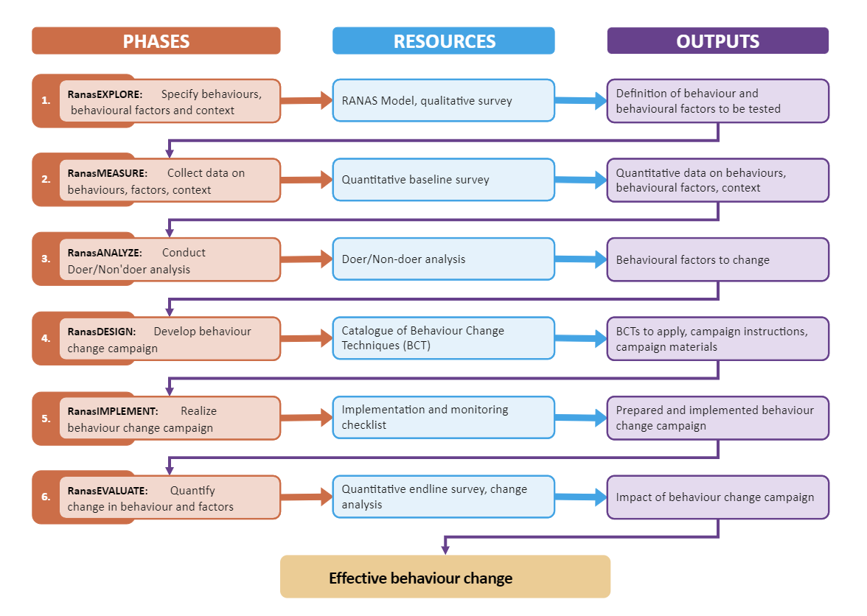
RANAS Approach
Step-by-step theory of change approach
Elements of RANAS are applied at each phase
Notes:
Discuss the RANAS applied theory of change. Combine with a case study
End off with talking about giving them a Mac book laptop. Is it the right tool for every job? No. Is it going to be suitable for many cases? Perhaps. I’m just giving them a model that is nicely packaged out of the box. I’m hoping that it will be a fantastic starting point when you consider developing your context specific theory of change. As you increase in your WASH knowledge, you will learn of other models, like a Dell laptop, or perhaps you might even learn the basic building blocks and theories for Behavior Change so that you can craft your own “PC” or appreciate how models like RANAS work under the hood. My friends at PETRAM weren’t as fortunate as you all, I made them spend time learning the foundational parts before presenting on the “MacBook” version.

Slide 12
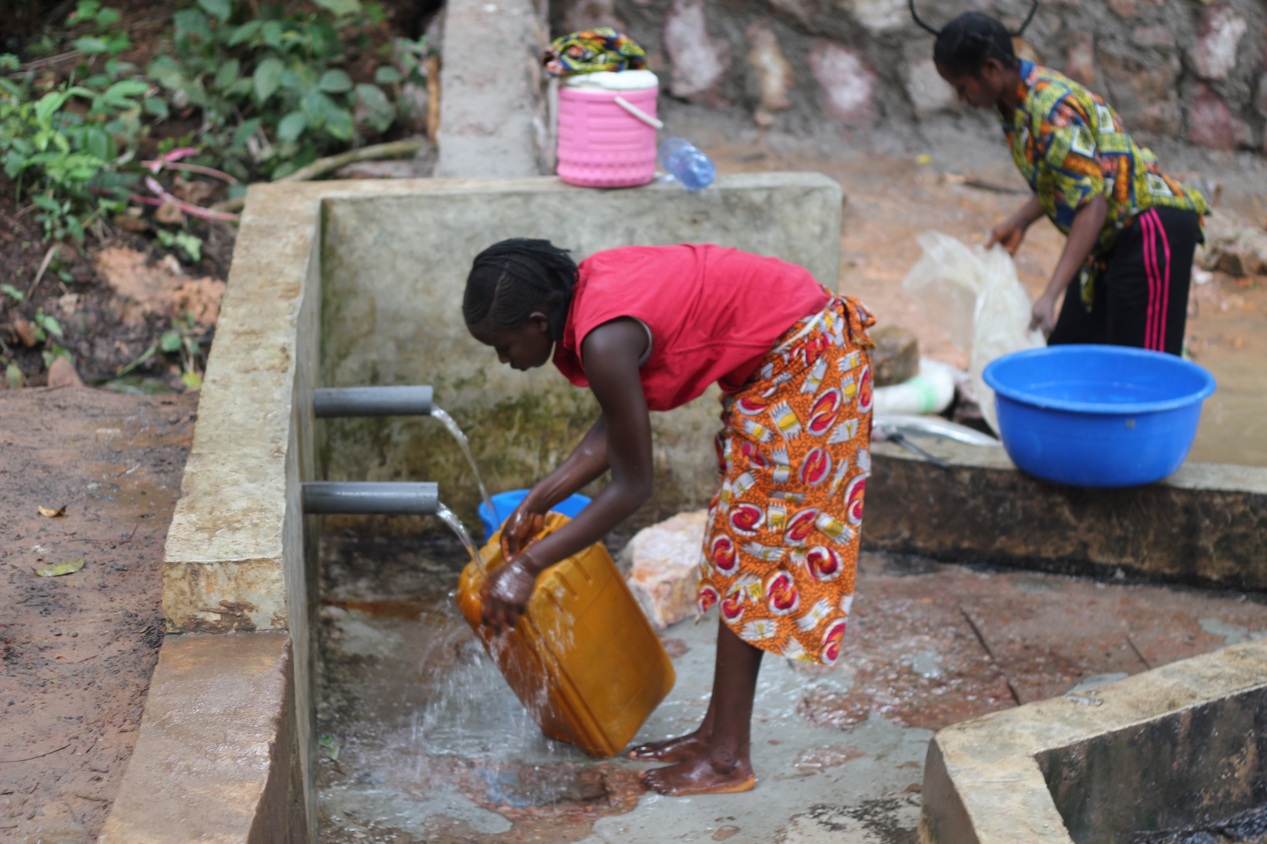
Goal: To apply the RANAS approach to improve handwashing behavior in rural Ethiopia
Case Study – Hand washing in Ethiopia (Mosler, Contzen, Meili, 2015)

Slide 13
Explore, Measure, Analyze
Household Community Surveys
Qualitative and Quantitative Behavior and Demographic Data
Doer/Non-Doer Analysis
Factors to Target: Social Norms, Barriers, Forgetting, Handwashing Knowledge
Notes:
Data collection through survey and comparison between doer/ non doers revealed that they needed to focus interventions on social norms, barriers, forgetting, and improving handwashing techniques

Slide 14
Design and Implement
Factors to Target
Education, Public-commitment, Infrastructure
Behavior Change

Slide 15
Ran another study 3 months after intervention which found that 50 – 80% of households had maintained handwashing behavior
Evaluate
Notes:
Data collection through survey and comparison between doer/ non doers revealed that they needed to focus interventions on social norms, barriers, forgetting, and improving handwashing techniques

Slide 16
Summary
Changing behavior is a higher priority than changing physical environments
A WASH theory of change should include a strategy to target intentions and habits
RANAS proposes to focus on Risk, Attitudes, Norms, Ability, and Self-Regulation factors to design a comprehensive WASH intervention
Notes:
I hope that this presentation has given you all a good starting point to think about WASH theory of change. Address limitations
Presented on one reputable and evidence-based behavior change theory as well as how it can be applied to create a practical theory of change for WASH.
Answer the question of where resources are available.

Slide 17
References
Ranas (2023). Methods Fact Sheet: The RANAS model of behavior change. Zurich, Switzerland. This Fact Sheet is copyright protected by Ranas Ltd. and may only be used under the Creative Commons license CC BYNC-ND 4.0.
Contzen, N., Meili, I. H., & Mosler, H.-J. (2015). Changing handwashing behaviour in southern Ethiopia: A longitudinal study on infrastructural and commitment interventions. Social Science & Medicine, 124, 103–114. https://doi.org/10.1016/j.socscimed.2014.11.006

